Slide 1
Network Administration
Responsibilities of the Network Administrator
As a network administrator, your tasks generally will fall into four areas
• Planning and Designing the network
• Setting up the network
• Maintaining the network
• Expanding the network

Slide 2
Network Administration
Designing the Network
The first phase in the life cycle of a network involves planning & creating its design, a task not usually performed by new network administrators. Designing a network involves making decisions about the type of network that best suits the needs of your organization
In larger sites this task is performed by a senior network architect: an experienced network administrator familiar with both network software and hardware

Slide 3
Network Administration
Setting Up the Network
After the new network is designed, the second phase of network administration begins, which involves setting up and configuring the network
This consists of installing the hardware that makes up the physical part of the network, and configuring the files and/or databases, hosts, routers, and network configuration servers

Slide 4
Network Administration
Maintaining the Network
The third phase of network administration consists of ongoing tasks that will typically comprise the bulk of your responsibilities. They might include:
• Adding new host machines to the network
• Network security
• Administering network services, such as NFS, name services, and electronic mail etc.

Slide 5
Network Administration
Expanding the Network
The longer a network is in place and functioning properly, the more your organization will want to expand its features and services. Initially, you can increase network population by adding new hosts and expand network services by providing additional shared software.

Slide 6
Network Administration
Several options are available for expanding your network:
Setting up a new network and connecting it to the existing network
Setting up a new network and connecting it to the existing network and connect through Internet to organization network
Connecting your network to the global Internet

Slide 7
Network Administration
Server
A network machine that provide services through network
It is powerful machine as storage, memory and processor
Mostly Network OS install on server machines
Client
A machine that request for services and use that services

Slide 8
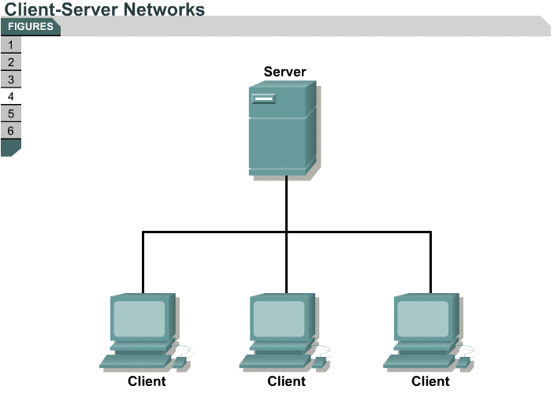
Network Administration

Slide 9
Network Administration
NOS
Windows NT Server
Windows server 2000
Windows server 2003
Windows server 2008
Windows server 2010
Linux red Hat
Suse

Slide 10
Network Administration
COS
Windows 98
Windows xp
Windows vista
Windows 7
Windows 8
Windows 10
Ubuntu

